Slide 1
Research and Instruction
2021-2022
At a GLANCE

Slide 2
Questions Answered
Library staff answered 469 questions in the fall semester and 315 in the spring semester for a total of 789 questions.
This is a 17% increase from the total of 673 questions answered during the 2020-2021 academic year when many students were learning remotely.
In the spring semester of 2019, library staff answered 1207 questions indicating a downward trend in service transactions post-pandemic.

Slide 3
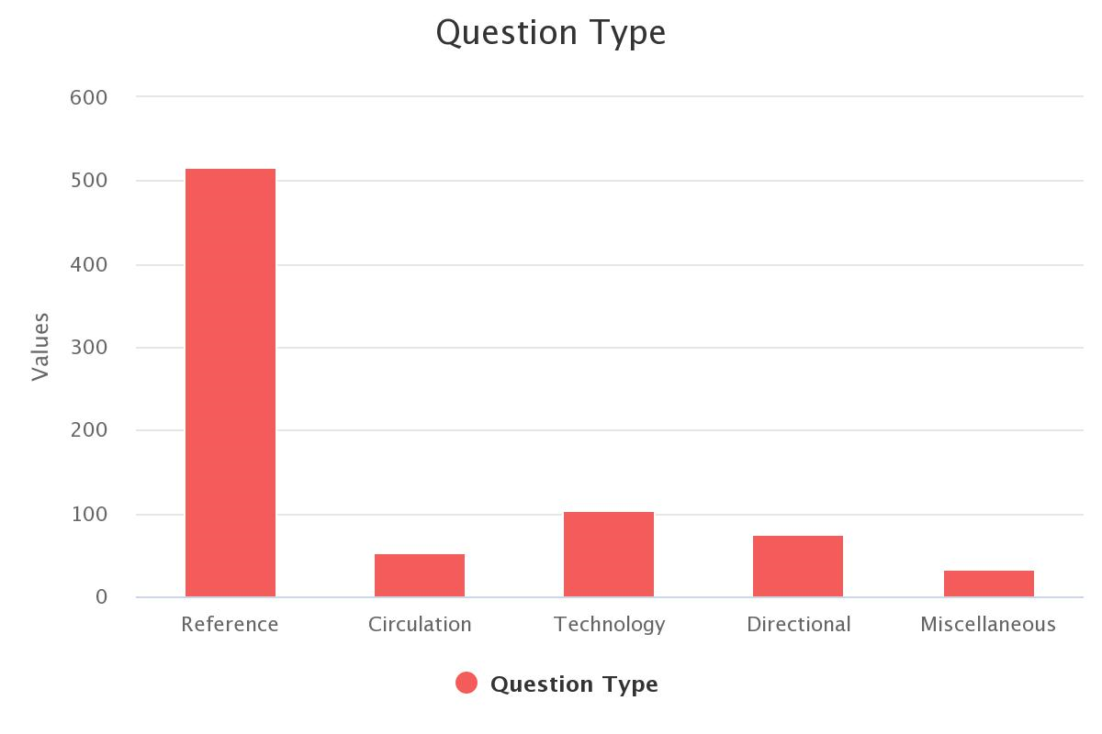

Slide 4
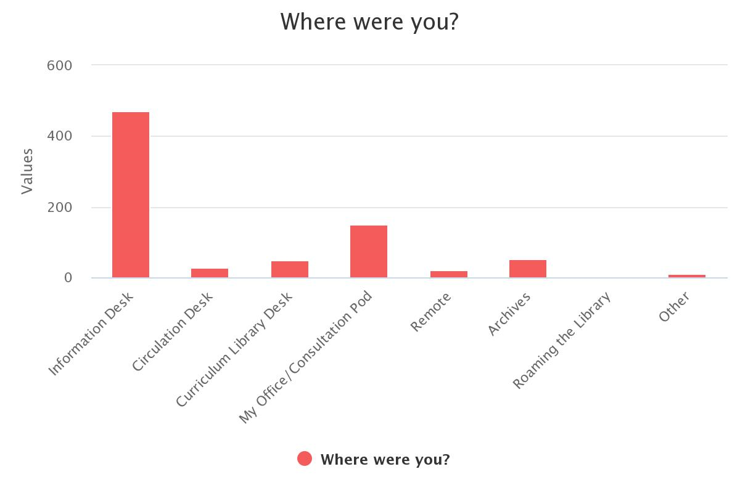

Slide 5
Library Instruction
Librarians taught 57 classes this semester and 91 in the fall semester for a total of 148 classes, a 13% increase from a total of 131 classes in the 2020 academic year.
This total includes:
graduate and undergraduate classes
in-class and asynchronous instruction
a series of library workshops for education majors

Slide 6
Library Instruction

Slide 7
Students Served

Slide 8
Instruction and Staffing
While the number of classes have remained consistent, the number of librarians teaching the classes has consistently declined.
2018–2019
149 classes taught by 8 librarians
2019–2020
175 classes taught by 7 librarians
2020–2021
131 classes taught by 7 librarians
2021–2022
148 classes taught by 5 librarians

Slide 9
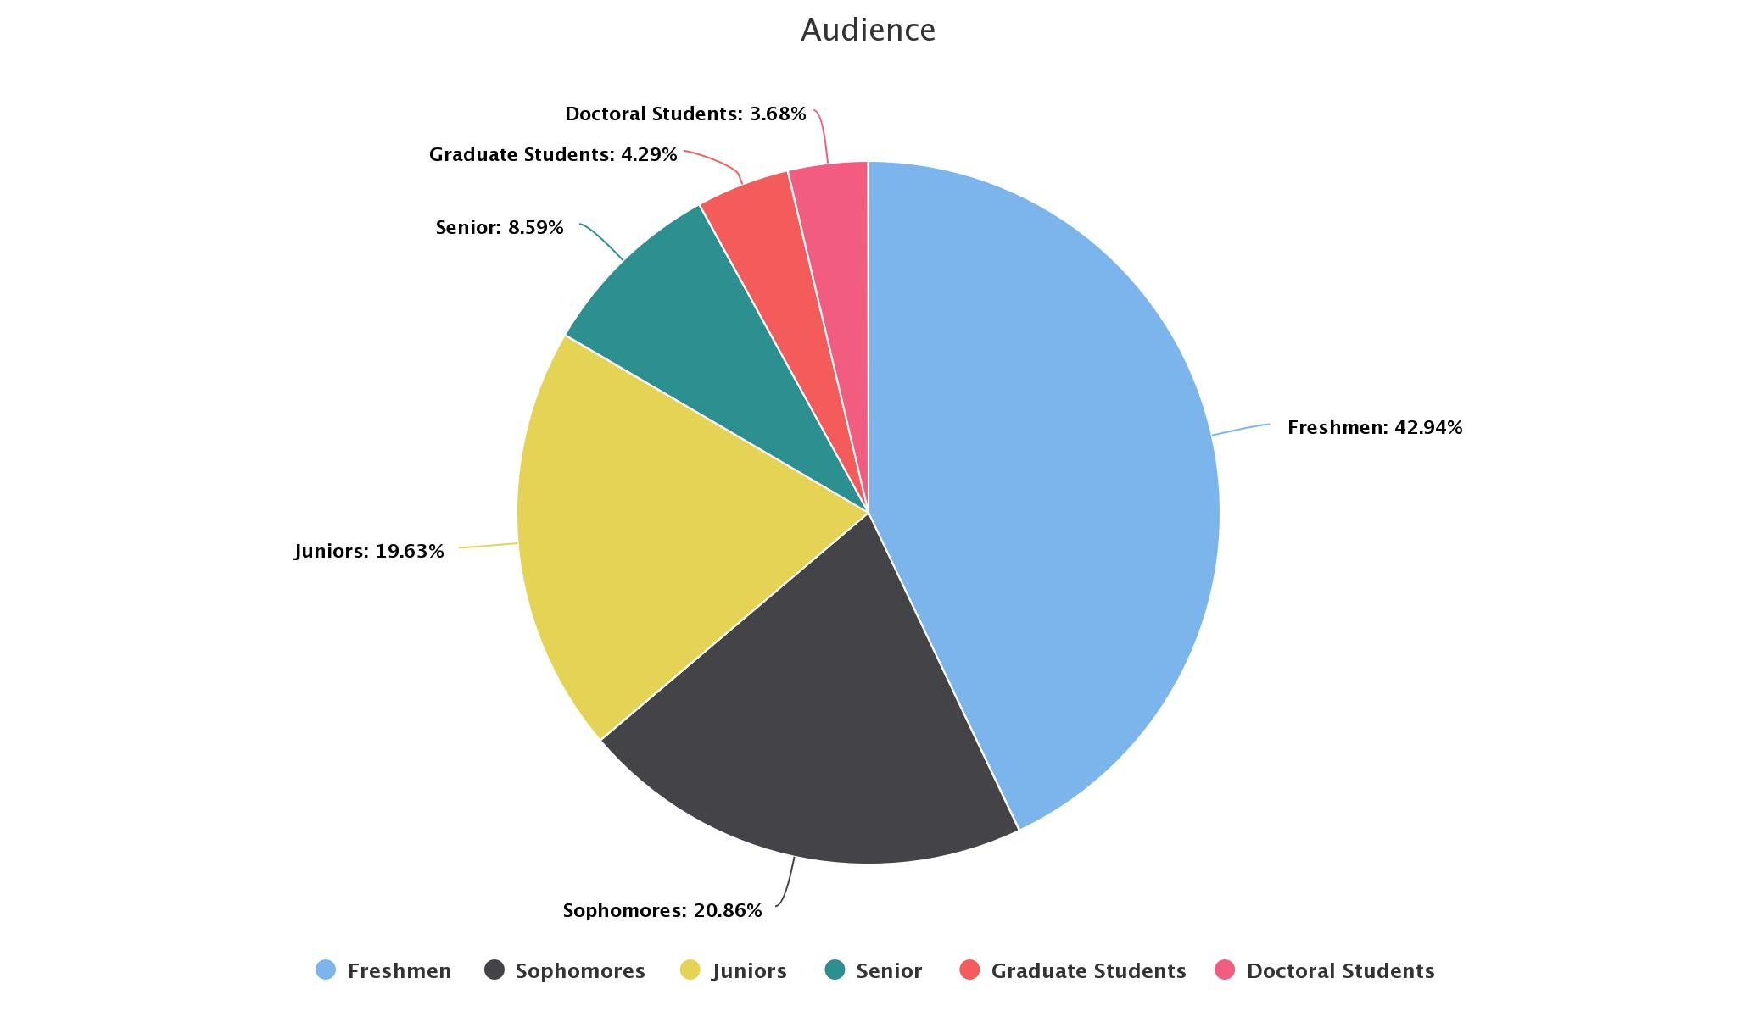

Slide 10
